Slide 1

Department of Computer Science and Engineering
(Cyber Security)
Project Title: BookBridge
A Web-Based Library Resource Management System
NAME: PONSURABHI V
REG NO: 241901077

Slide 2
ABSTRACT
BookBridge is a web-based library resource management system developed to simplify library operations through an interactive and centralized web application. The system provides separate interfaces for administrators and members. Administrators can manage book information, member records, and book circulation, while members can browse the library catalogue and check book availability. The application uses React.js to develop a dynamic user interface, PHP to process backend requests, and MySQL to store application data. BookBridge demonstrates the integration of frontend development, server-side programming, database connectivity, and client–server communication in a practical web application.

Slide 3
PROBLEM STATEMENT
Existing Problem
Managing library resources manually can be time-consuming and may lead to difficulties in maintaining accurate book and member records.
Common challenges include:
Difficulty searching for specific books.
Time-consuming updates to library records.
Challenges tracking book availability.
Errors in issue and return records.
Limited accessibility to library information.
Lack of a unified web-based interface.
Proposed Solution
BookBridge provides a centralized web application that simplifies access to library information and supports digital management of books, members, and circulation activities.

Slide 4
PROJECT OBJECTIVES
Develop an interactive and user-friendly library website.
Implement responsive web pages using modern frontend technologies.
Create separate interfaces for administrators and members.
Implement user authentication.
Provide book searching and availability information.
Develop backend functionality using PHP.
Integrate MySQL for persistent data storage.
Implement book issue and return operations.
Test the functionality and usability of the application.

Slide 5
TOOLS & TECHNOLOGIES
Category | Technology | Purpose
Frontend | React.js, HTML5, CSS3, JavaScript | User interface and interactive web pages
Backend | PHP | Server-side logic, authentication, and request processing
Web Server | Apache (XAMPP) | Running the PHP backend
Database | MySQL | Storing book, user, and circulation data
Database Management Tool | phpMyAdmin | Managing the database
Development Environment | Visual Studio Code | Coding and debugging
Runtime and Package Manager | Node.js and npm | Running React and managing packages
Build Tool | Vite | Frontend development server and build
API Communication | PHP API | Connecting frontend and backend
Version Control | Git | Tracking code changes

Slide 6
LITERATURE SURVEY
S.No. | Author / Year | Study | Key Findings
1 | Shailendra K. & Namrata Rai (2011) | Web Interface in Library Management Systems | Discussed web-based library interfaces, databases, security, and library automation. (ResearchGate)
2 | Wang (2009) | Integrated Library System Challenges and Opportunities | Examined challenges in implementing and migrating integrated library systems. (ScienceDirect)
3 | Design and Implementation of Web-Based Library Management System (2023) | Automated Library Management | Explored browser-server architecture, MySQL database integration, and functional testing. (IEEE Xplore)
4 | Asim & Arif (2025) | Adoption of Koha Integrated Library Software | Identified benefits of library automation, including improved cataloguing and library services. (Taylor & Francis Online)

Slide 7
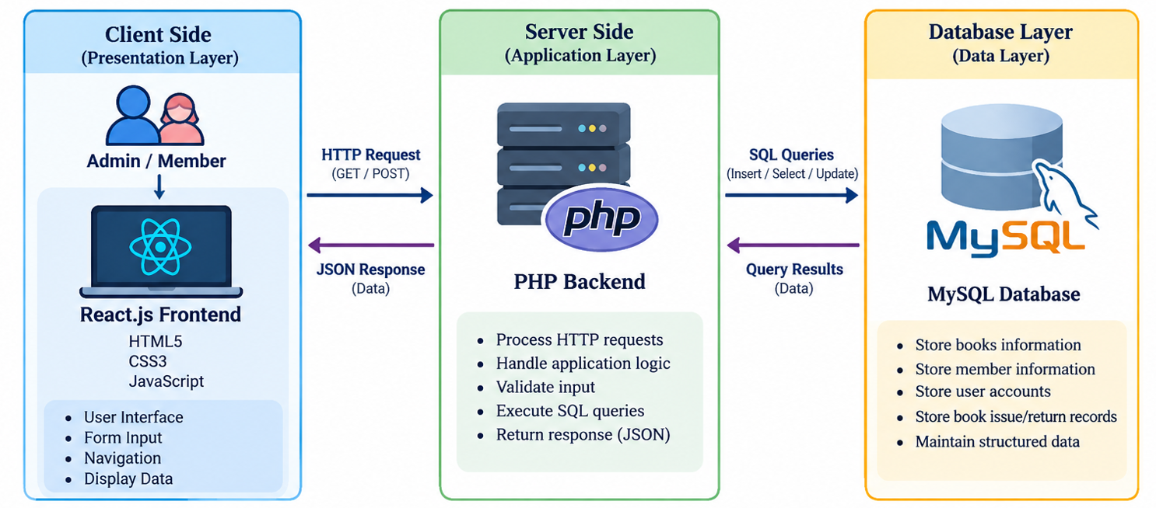
SYSTEM ARCHITECTURE

Slide 8
WEBSITE MODULES
1. Authentication Module
Provides a login interface.
Validates user credentials.
Supports administrator and member access.
2. Book Catalogue Module
Displays available book information.
Supports searching for books.
Shows relevant book details and availability.
3. Admin Dashboard
Provides access to administrative features.
Supports library management operations.

Slide 9
WEBSITE MODULES
4. Member Management Module
Allows administrators to manage member records.
5. Circulation
Module
Supports issuing books to members.
Records book returns.
Maintains circulation information.

Slide 10
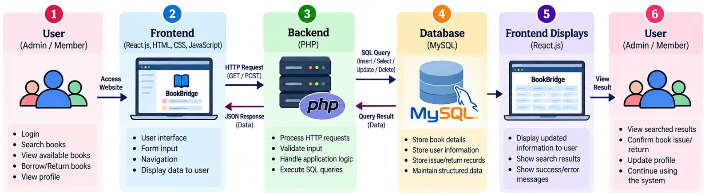
WEBSITE WORKFLOW

Slide 11
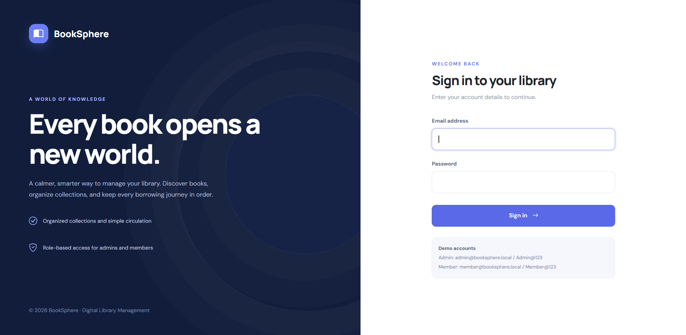
USER INTERFACE DESIGN
Website Interface
BookBridge provides an interactive interface designed to make library operations simple and accessible.
Login Page
Accepts user credentials.
Provides access to the application.

Slide 12
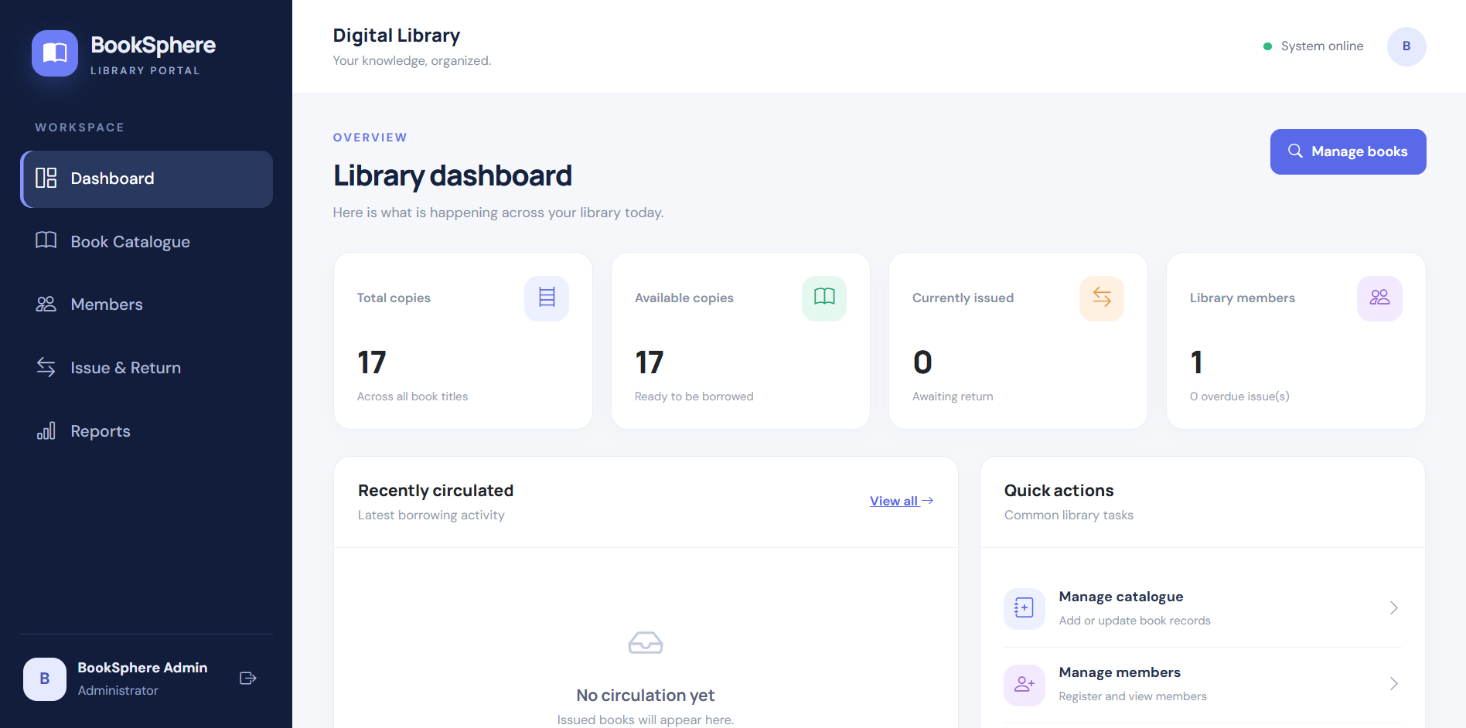
USER INTERFACE DESIGN
Admin Dashboard
Displays administrative navigation and management options.

Slide 13
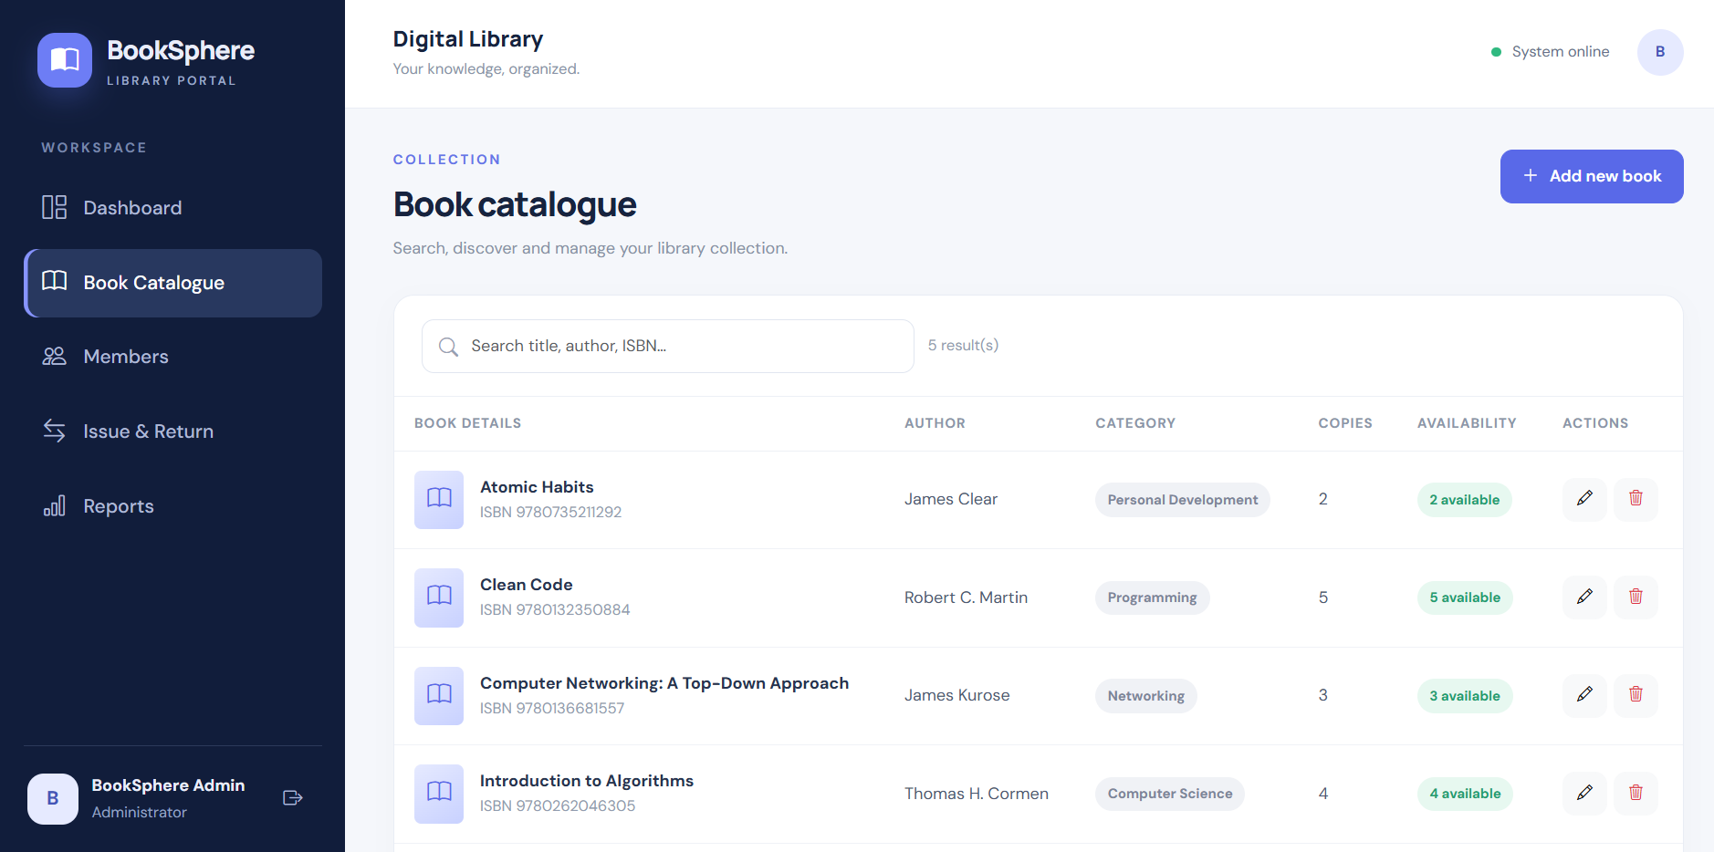
USER INTERFACE DESIGN
Books Page
Displays the library catalogue.
Provides book search and availability information.

Slide 14
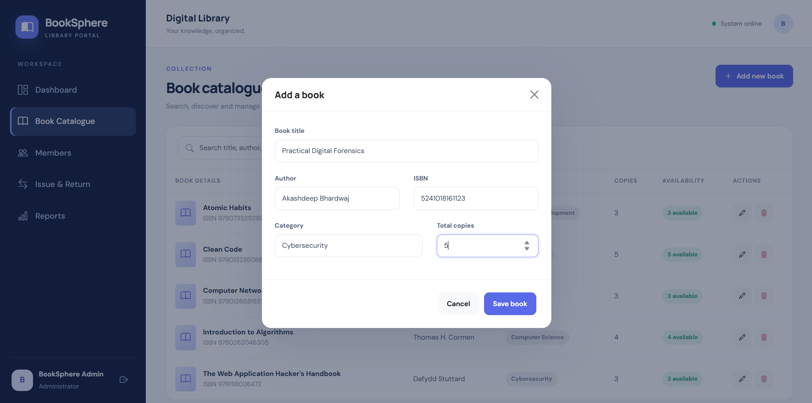
USER INTERFACE DESIGN
Add Book:
Allows the admin to add new books by entering the title, author, ISBN, category, and total number of copies.

Slide 15
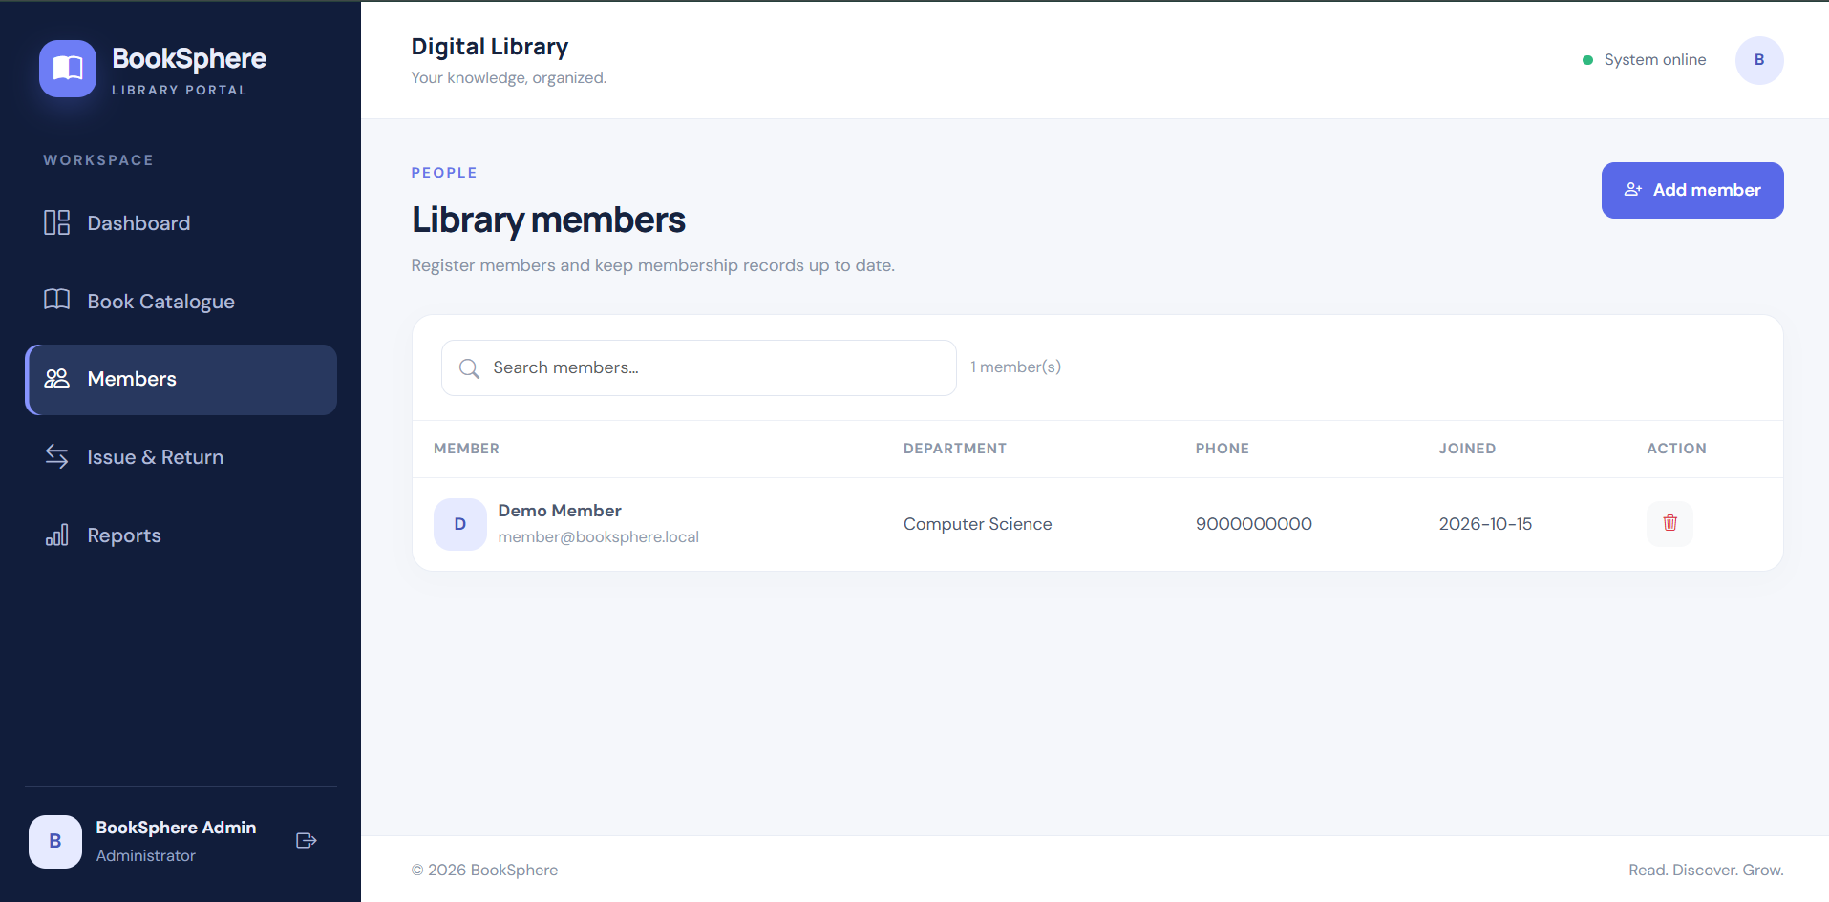
USER INTERFACE DESIGN
Members Page
Provides member management functionality for administrators.

Slide 16
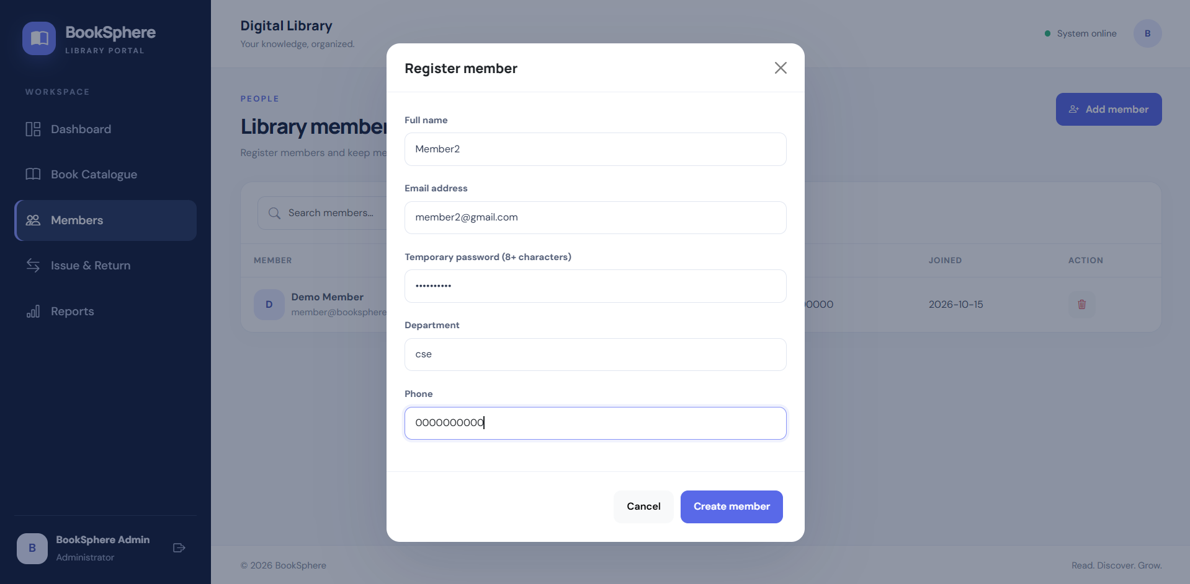
USER INTERFACE DESIGN
Register Member:
Allows the admin to register new library members by entering their name, email, temporary password, department, and phone number.

Slide 17
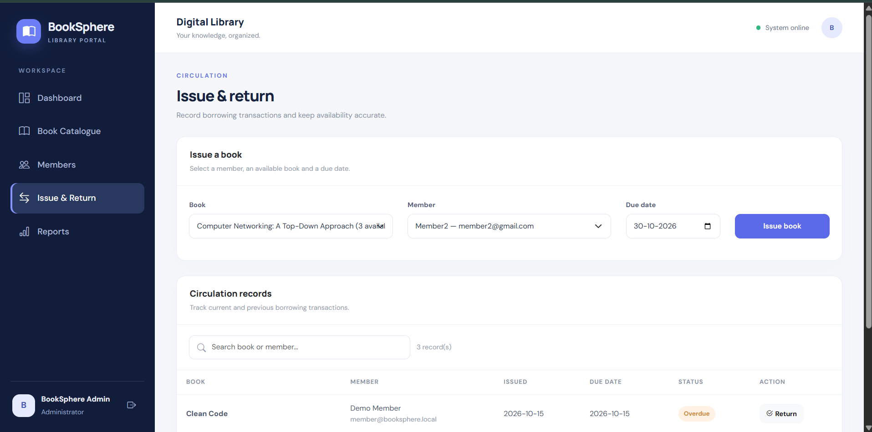
USER INTERFACE DESIGN
Issue & Return:
Enables the admin to issue books to members with due dates, track borrowing records, and process book returns.

Slide 18
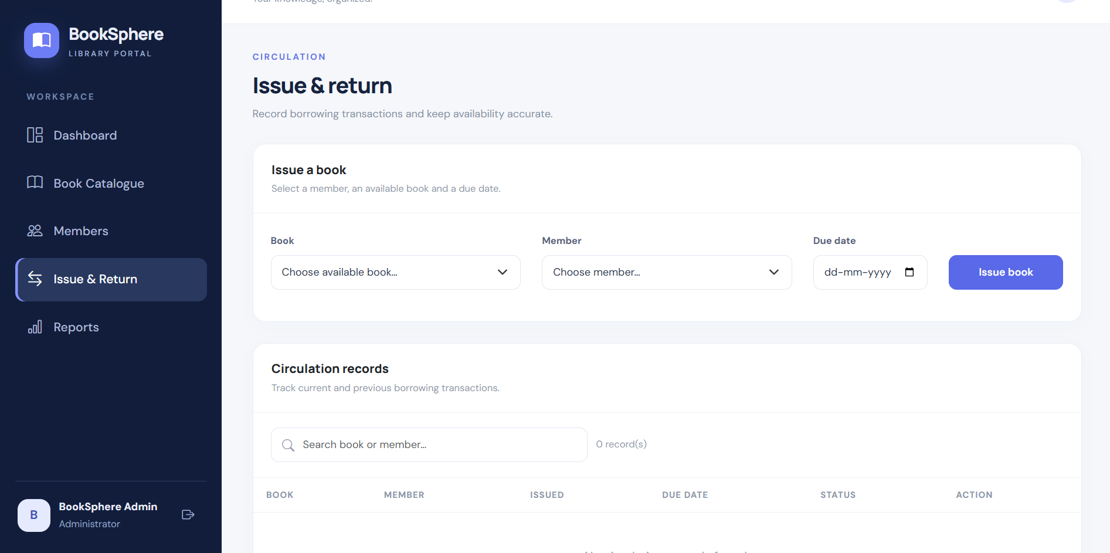
USER INTERFACE DESIGN
Circulation Page
Provides book issue and return functionality.

Slide 19
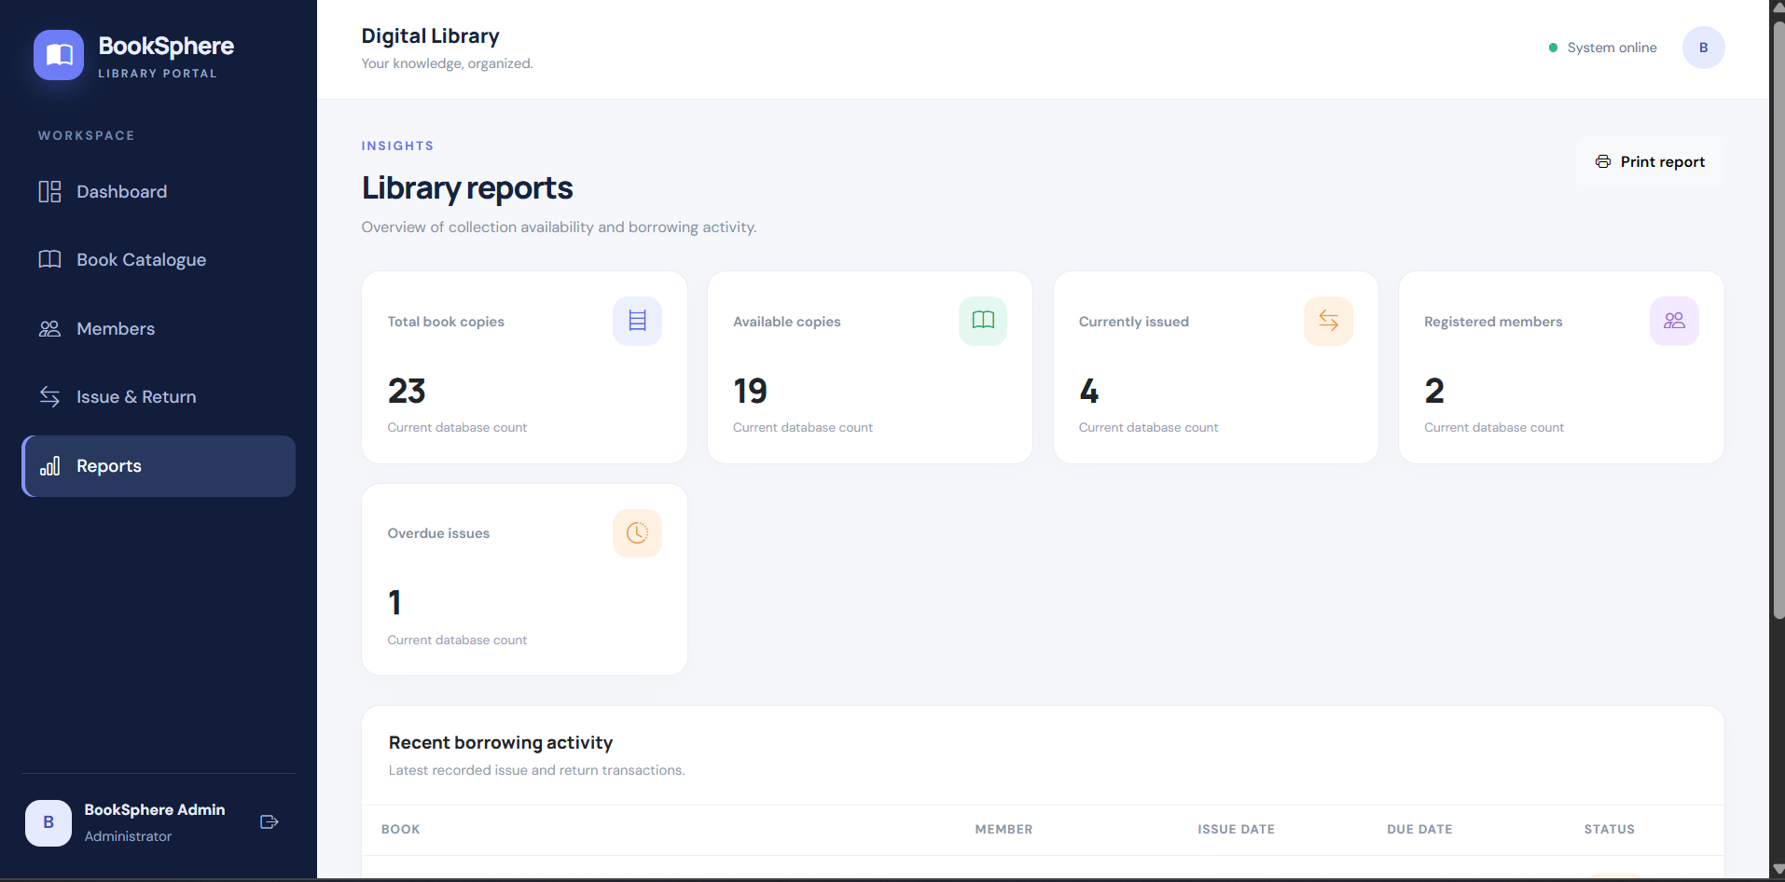
USER INTERFACE DESIGN
Reports:
Displays library statistics, including total book copies, available books, currently issued books, registered members, and overdue issues.

Slide 20
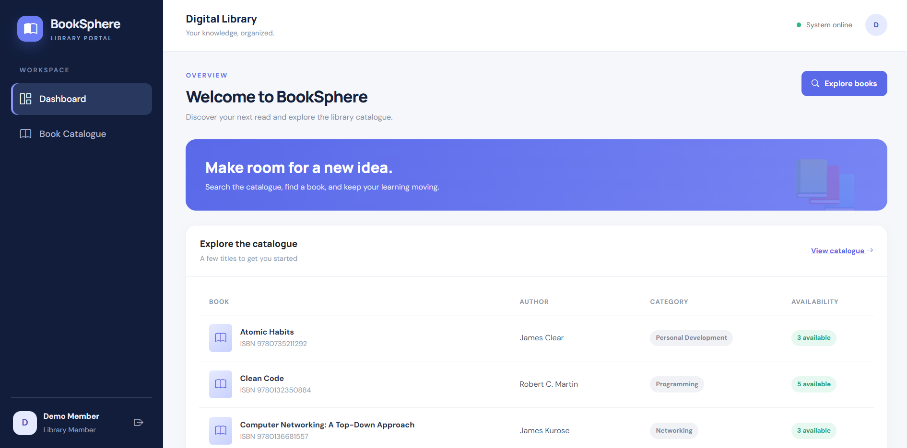
USER INTERFACE DESIGN
Member Dashboard: Displays an overview of the library with selected books and their availability.

Slide 21
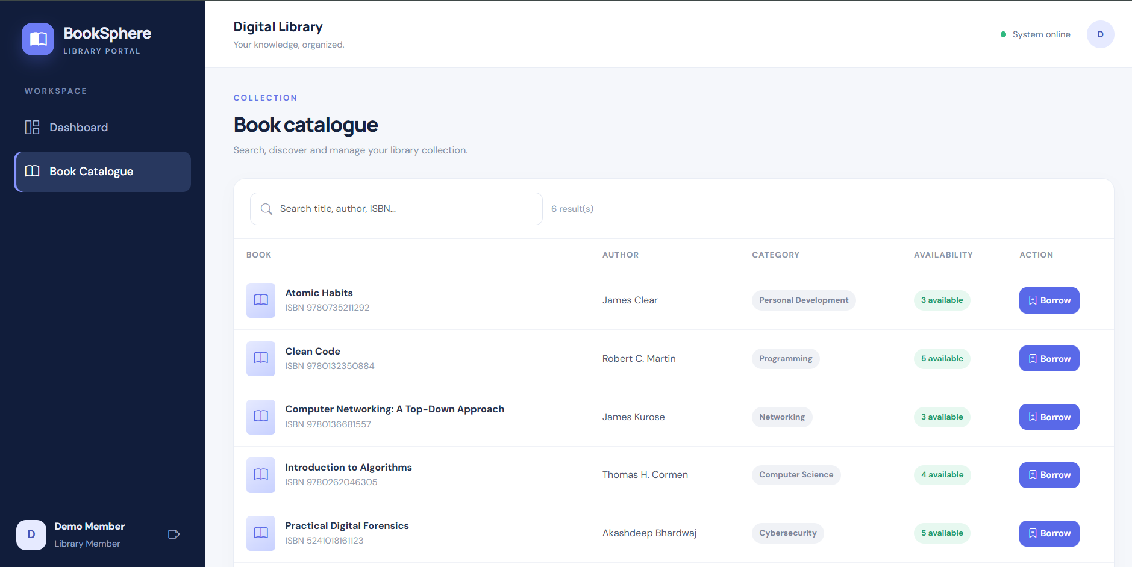
USER INTERFACE DESIGN
Book Catalogue:
Implements book search by title, author, or ISBN and displays book details, availability.

Slide 22
IMPLEMENTATION
Frontend Implementation
Developed using React.js.
Uses reusable components to organize the interface.
Implements interactive elements using JavaScript.
Uses CSS for styling and layout.
Communicates with backend endpoints to retrieve and update information.
Backend Implementation
Developed using PHP.
Handles HTTP requests from the frontend.
Validates input and processes application logic.
Executes database operations using MySQL.
Returns responses to the frontend in JSON format.

Slide 23
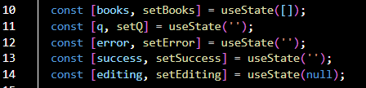
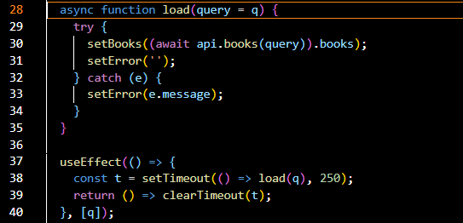
IMPLEMENTATION
Technique: State Management and Hooks (Books.jsx)
Techniques used:
useState() manages book data, search input, and messages.
useEffect() handles data loading when the search query changes.
React hooks manage dynamic UI updates.
Technique: API Integration and Debouncing (Books.jsx)
Techniques used:
Fetches book records through the API service.
Implements a 250 ms delay to reduce frequent search requests.
Uses error handling to display failures.

Slide 24

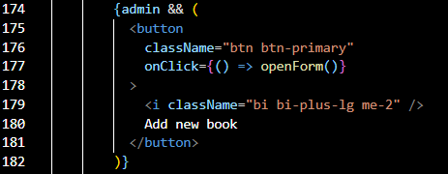
IMPLEMENTATION
Technique: Role-Based Access Control (Books.jsx)
Techniques used:
Identifies the logged-in user's role.
Displays administrative controls only to admins.
Separates admin book management from member book browsing.

Slide 25
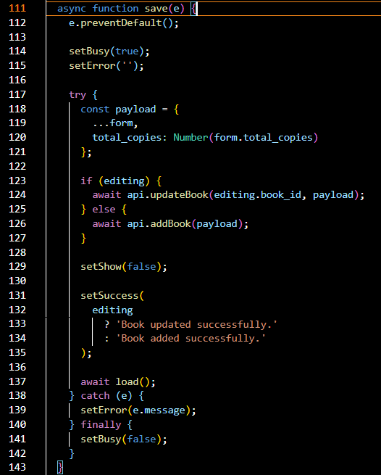
IMPLEMENTATION
Technique: Form Handling and CRUD Operations (Books.jsx)
Techniques used:
preventDefault() prevents the form's default submission.
Supports both adding and updating books.
Converts the total copies input into a number.
Handles errors and loading state.

Slide 26
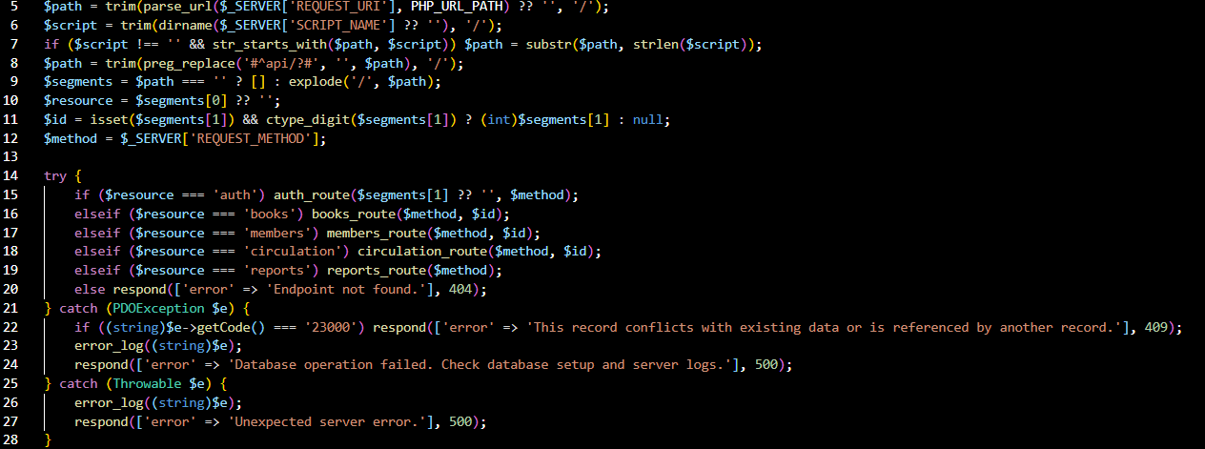
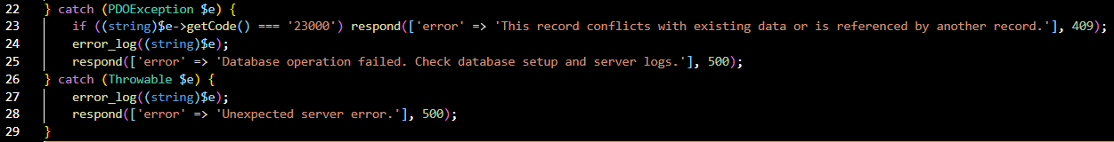
IMPLEMENTATION
Technique: API Routing and Exception Handling (index.php)
Techniques Used
URL Parsing: Identifies the requested API endpoint.
Request Routing: Directs requests to authentication, books, members, circulation, or reports handlers.
HTTP Methods: Identifies the request method, such as GET or POST.
Error Response: Returns HTTP 404 when an endpoint is not found.
Handles database and unexpected server errors.

Slide 27
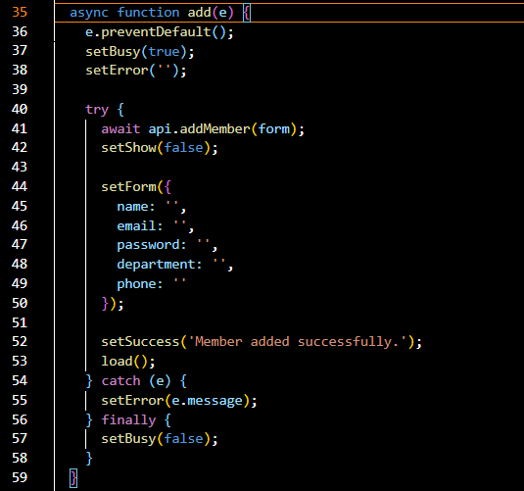
IMPLEMENTATION
Technique: CRUD Operations and API Integration (Members.jsx)
Techniques used:
preventDefault() handles form submission without a page reload.
API integration sends member details to the backend.
try-catch-finally handles errors and resets the loading state.
Success and error messages provide feedback to the user.

Slide 28
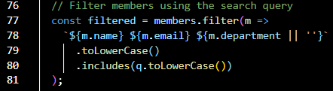
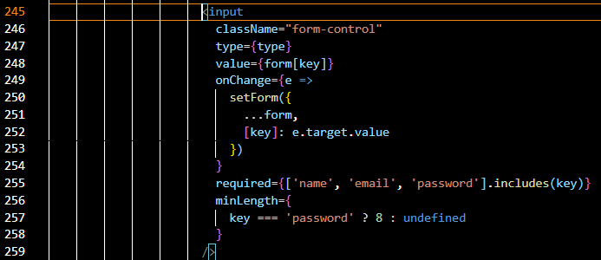
IMPLEMENTATION
Technique: Array Filtering(Members.jsx)
Techniques used:
Uses .filter() to find matching members.
Searches names, email addresses, and departments.
Converts text to lowercase for case-insensitive searching.
Updates displayed results when the search query changes.
Technique: Controlled Components and Input Validation (Members.jsx)
Techniques used:
Controlled inputs store form values in React state.
onChange updates the form data.
required validates mandatory fields.
minLength requires passwords to contain at least eight characters.

Slide 29
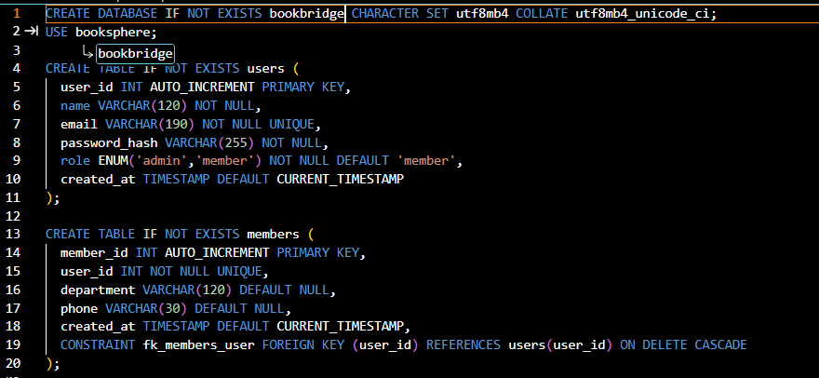
IMPLEMENTATION
Technique: Relational Database Design and Referential Integrity (bookbridge.sql)
Techniques Used
Primary Key: Uniquely identifies each book and issue record.
Foreign Key: Connects borrowing records to books and members.
UNIQUE Constraint: Prevents duplicate ISBN values.
NOT NULL: Ensures required fields contain values.
CHECK Constraints: Help prevent invalid copy counts.
ENUM: Restricts issue status to Issued or Returned.

Slide 30
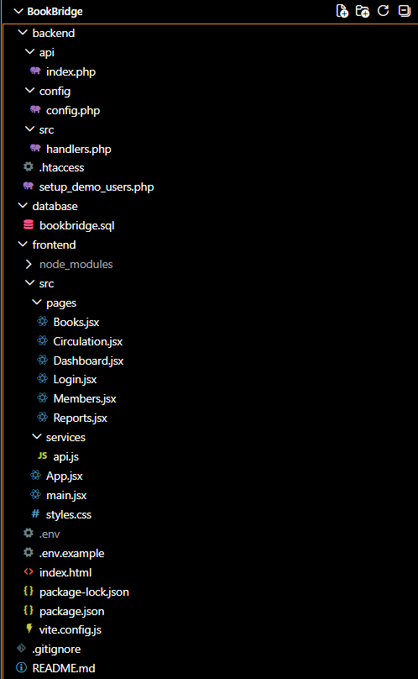
PROJECT STRUCTURE & FILE ORGANIZATION

Slide 31
TESTING AND RESULTS
Tested login and authentication for admin and members.
Verified book catalogue search and book availability.
Tested adding books and registering members.
Verified book issue and return operations.
Checked report generation and database updates.

Slide 32
CONCLUSION
BookBridge is a web-based library management system designed to simplify library operations. It provides features for book catalogue management, member registration, book issue and return tracking, and report generation. The system uses React.js for the frontend, PHP for the backend, and MySQL for database management. It helps maintain organized records, monitor book availability, and improve the efficiency of library management.

Slide 33
FUTURE ENHANCEMENTS
Implement automated email reminders for due dates.
Introduce automatic fine calculation for overdue books.
Add online book reservation functionality.
Generate downloadable library reports.
Develop a mobile-friendly application for easier access.

Slide 34
REFERENCES
[1] Shailendra, K., & Rai, N. (2011). Literature review of research on web interface in library management software systems. DESIDOC Journal of Library & Information Technology, 31(4), 262–274.
[2] Wang, Z. (2009). Integrated library system (ILS) challenges and opportunities: A survey of U.S. academic libraries with migration projects. The Journal of Academic Librarianship.
[3] Design and implementation of web-based library management system. (2023). Proceedings of the International Conference on Information Processing and Network Provisioning.
[4] Asim, M., & Arif, M. (2025). Adoption of Koha integrated library software in university libraries: A systematic literature review. Serials Review, 51(1–2), 54–64.
[5] React. (n.d.). React documentation. https://react.dev/
[6] PHP. (n.d.). PHP documentation. https://www.php.net/docs.php
[7] Oracle. (n.d.). MySQL documentation. https://dev.mysql.com/doc/

Slide 35
Thank you

